Slide 1
Basic Stamp-Final Project

Slide 2
MATERIALS USED
Basic Stamp
Misc. Wire
LED Lights
7-Segment LED Display-Cathode

Slide 3
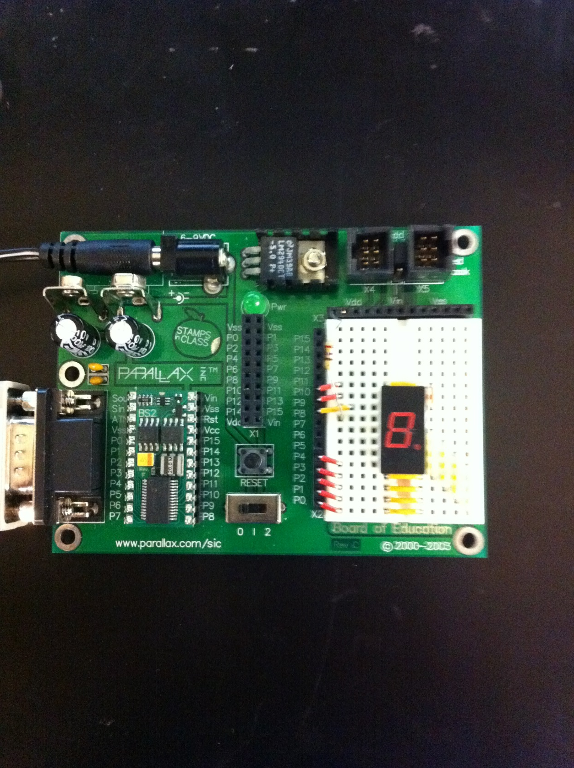
7-segment display
Resistor
pins

Slide 4
